Slide 1

Professional services for Salesforce Maintenance, Minor Enhancement and Support Services Cognizant Presentation
March 2020

Slide 2
Topics for Discussion
Sl. No. | Topic
1 | Introduction
2 | Brief overview of our company
3 | Overall approach for the Run portion from transition to steady state to continuous improvement How will Cognizant manage peak support period during June / July and a high workload through the end of the year
4 | How will Cognizant resource both the transition and run portions of this contract whilst maintaining the knowledge gained in transition?
5 | Explain the engagement/ operating model for the Run portion – teams/ people/ locations/ interactions
6 | Support for a highly customized solution is different from a standard configured solution, please explain your approach, the challenges you anticipate and how you propose to tackle those challenges
7 | Specific to Apttus and Excel, the knowledge of these tools is very critical for a successful support function. For example, extract and upload of templates which may have validation issues
8 | In case of staff turnover or additional resource needed, please describe the on-boarding process / lead time

Slide 3
Topics for Discussion
Sl. No. | Topic
9 | How Cognizant proposes to achieve a flexible model on support function – when additional resources are required or when new launches / functionalities are added or decommissioned
10 | One of our key objectives around vendor engagement as part of the new IT Vision is to move away from an operational relationship to a more strategic partnership based engagement model. What specific value proposition and approach are you bringing to support this objective. We are looking for a partner whom we can rely on, how will you ‘own’ this service.
11 | How would Cognizant use their current on site knowledge and expertise to improve the delivery of the contract, what synergies do you see?
12 | What are the legally binding commitments which the vendor is ready to be included in the contract regarding the support? % of reduction of the # of tickets More aggressive SLAs Decreasing costs Penalties if some KPIs are not achieved

Slide 4
Introduction

Slide 5

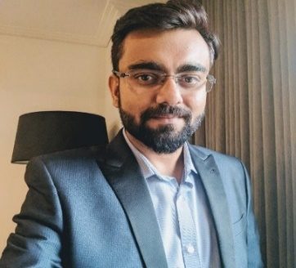

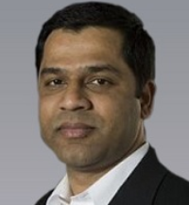
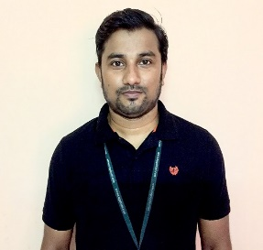
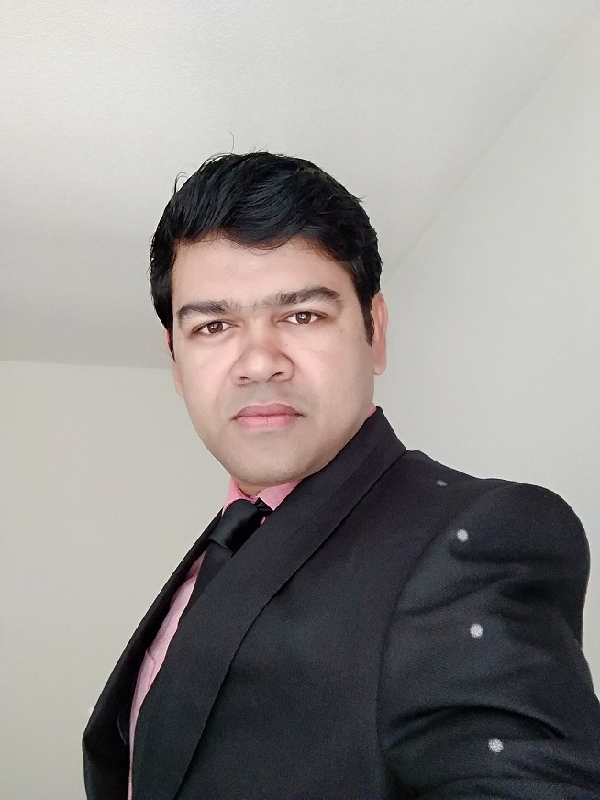
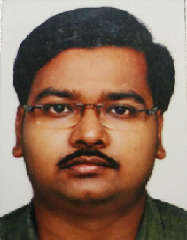
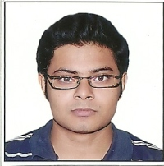

Cognizant Team with you today
Vibhor Singh
Salesforce Practice Lead, Europe
Abhirup Bose
Onsite Service Delivery Manager
Mohit Sawant
Client Partner
Manas Majumder
Onsite SFDC Sr. Salesforce Specialist
Pallab Mukherjee
Offshore Delivery Director
Soumya Shantabag
Onsite SFDC Technical Analyst
Arbhik Roy
Offshore SFDC Automation Tester
Alain Solioz
Salesforce Architect

Slide 6
Brief overview of Cognizant

Slide 7







OUR OVERVIEW
Founded
in 1994 (CTSH, Nasdaq)
~292,500
Employees
Cognizant (NASDAQ-100: CTSH) is one of the world’s leading professional services companies, transforming clients’ business, operating and technology models for the digital era. Our unique industry-based, consultative approach helps clients envision, build and run more innovative and efficient businesses. Headquartered in the U.S., Cognizant is ranked 193 on the Fortune 500 and is consistently listed among the most admired companies in the world.
Headquarters
Teaneck, NJ
100+ Global
Delivery Centers
Revenue Mix
NA: 75.7%
Europe: 17.8%
RoW: 6.3%
Revenue
$16.8 B in FY 2019
ACCOLADES
11
Fortune
Most Admired Companies Years in a Row
193
Fortune
500
16
Barron
100 Most Sustainable Companies 2018
74
Forbes
Best Employers for Women 2018
524
Forbes
Global 2000

Slide 8

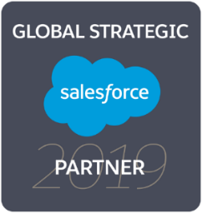
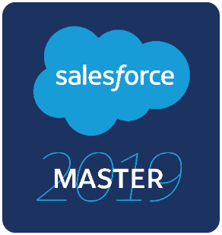
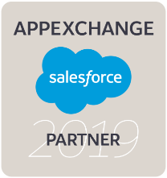

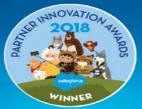



We have one of the largest Salesforce practice in the world
2nd
5 x
LEADER
Largest Pool of Certified Consultants
MAGIC QUADRANT FOR CRM AND CUSTOMER EXPERIENCE IMPLEMENTATION SERVICES, 2018
SALESFORCE PARTNER NNOVATION AWARD
2014, 2015, 2016, 2018, 2019
Growth Investments
500⁺
2000⁺
9.92/10
Clients
Enterprise Projects
CSAT Score
#1 Implementation partner for Salesforce CPQ and Billing
7500⁺
75⁺
4⁺
Largest independent SI & fastest to Platinum partner status in Australia & India
Salesforce Consultants
Tools and Accelerators
Customer Success Centers

Slide 9

We have been providing similar Salesforce services to industry leaders across the world
SIMILAR ENGAGEMENTS
BY THE NUMBERS
Leading Agrochemical company
Global Salesforce Support for 65+ applications
US based Healthcare Major
Maintenance and Support for 25+ Applications catering to Sales and Order Management
Global Manufacturing Company
Support & Enhancement for Salesforce applications covering Sales, Service and Marketing
350+ Support Engagements
150+ Clients
70%+ Engagements are managed in DevOps mode

Slide 10
We have deep expertise in building and supporting custom Salesforce Applications
Global Salesforce Support for a leading Agrochemical company with 65+ Applications
30%
9.9
25%
€5Mn+
Improvement in MTTR
Engagement CSAT
YOY Productivity Savings
Savings over 3 yrs.
12%
15%
Maintenance & Support of 25+ Salesforce Applications for a Health Care major
Less Tickets
Reduction in Incident Resolution Time
Application Support for a custom Salesforce application for a Global Manufacturing corporation
99%+
6%
20%
Response Time SLA Adherence
Reduction in P1 Tickets
Faster Deployment of Enhancements

Slide 11
Our successful application support engagement with TGF
23
Applications Supported
6
Resources at TGF
(Heavy onsite presence with Technical & Functional expertise)
~2.8k
INC, SR & ME handled
in 6 months (1-Sep-19 to till date)
Key Applications
Package 1: GFS, Workday, Wambo, Hyperion, iLearn
Package 2: Tableau, Informatica, Dell Boomi, SSIS/ SSRS, Database
Package 3: SharePoint, Adobe eSign
Scope of Work
Incident Management & Service Requests provisioning
Change Management
Problem Management
Minor Enhancements
Regression testing
Deployment requests Support for Disaster Recovery test
Key Highlights
Successful transition at a short duration (~2.5 months - incl. Shadow share phase)
Streamlined the Process in collaboration with TGF SMEs; One Team mindset (Cognizant & TGF IT) while handling support
98.69% & 99.33% SLA Adherence on Response and Resolution KPIs
2 Automation use case In Progress (SharePoint & iLearn) – potential to reduce ~40 tickets/month
Analysis In Progress in Wambo automation (Regression testing & User Management)

Slide 12
Overall approach for the Engagement – from transition to steady state to continuous improvement

Slide 13








Our Understanding of Scope
Technology
In Scope Services
Salesforce (applications both on Classic and Lightning)
Force.com
Community Cloud
Einstein Analytics
X-Author
GridBuddy
Incident Management and Problem Management (L1.5**, L2, L3)
Service Request fulfillment
Knowledge Management
Change Requests and Enhancements (20 Person Days’ effort per month)
SLA monitoring / Reporting
Release and Change Management
Deployment and Environment Management
Post Deployment Support for code changes / enhancements
Regression Testing
System Administration
Volumetric
Application
Landscape
Ticket Volumes
L1 – 3500/yr. Salesforce tickets
Incidents – 1900/yr.
Service Requests – 400/quarter
Users
Salesforce & Salesforce Platform – 750
Community Portal - 1600
TECHNOLOGY
SCOPE OF SERVICES
Application Portfolio:
Grant Operating System (GOS)
Strategy Implementation Plan Tracker (SIP Tool)
Procurement KPI Reporting (Sourcing Portal)
Distribution List Management & External User Provisioning
LANDSCAPE
ESTATE SIZE
TGF Application Portfolio
Coverage Expected
8 AM – 7 PM CET on Monday – Friday (11*5)
(Support over weekends/non-business hours during critical defect fixes or major projects)
**Note : Based on our reading of the RFP document, the services TGF is expecting as part of Level 1 Support translates to Level 1.5 in ITIL terminology. Accordingly, we will refer L1 support as L1.5 in subsequent sections of this document

Slide 14
As a starting point, Cognizant has performed a deep-dive analysis of the Ticket dump TGF shared
60% of tickets are raised as data or application incidents/failure and 40% service requests or how to questions.
Approx. 60% tickets are related to data (data update + fix). Out of these substantial number of tickets are raised through automated batch job failures.
Around 15% of tickets are SFDC administration tasks.
51% of ticket volume raised are Low, 42% as Medium, 6% raised as High/Critical priority.
There are ~250 tickets raised over 2 years which needed Code Change or Enhancements
Incident/Service | Count of Category | % Of Volume
customer feedback | 7 | 0.08%
failure | 4836 | 60.1
service | 3199 | 39.8
Total (2 yrs.) | 8044
Ticket Priority | Volume (2 yrs.) | % Count
Critical | 25 | 0.31%
High | 472 | 5.58%
Low | 4122 | 51.20%
Moderate | 3425 | 42.60%
Total (2 yrs.) | 8044 | 100%

Slide 15




Based on our analysis of your situation – following are the key areas we have focused on from a Solution standpoint
Skewed Ticket Resolution among the various Support levels – limited resolution happens at L1.5** and high count of L3 tickets
Challenges in handling data issues resulting from porting of data from excel templates to Salesforce
Lack of Scalability during peak times
Challenges in business interaction and governance due to limited Onshore presence
Less Aligned Priorities between Application Issues and resulting Business Impact
Challenges in effective business usage of key functionalities in the GOS Application
**Note : While the RFP document asks Cognizant to provide L1 Support, based on equivalence with ITIL terminology in terms of activities expected, we are calling it as Level 1.5.

Slide 16






Key Solution tenets tailored to address these focus areas as part of Cognizant approach
Effective Business Interaction and Governance at the engagement level
Increased Ticket resolution at Lower levels of Application support
Align service agreements to business impact
OVERALL Service Delivery Manager for delivery governance (incl. non–Salesforce application packages)
Business Analyst to identify process gaps & resolve issues
SOP based Resolution (L1.5**) for simple incidents – “Shift Left”
Trend Analysis to identify recurring incidents and fix suggested root causes for issue reduction
Up-to-date application and process documentation
Recalibrate existing SLA’s to align with business level agreements
Challenges in Optimal Application usage on the part of Users
Scalability of the Solution
Data issues arising during MS Excel to Salesforce data migration
Self-help for Business Users for quick turnaround and avoid errors due to multiple hand-shake between business users and support team
Periodic Review of Incident Volumes and support capacity to suggest incremental ramp-ups / downs in addition to the core support team
Team with prior experience of X-Author tool to reduce incident count arising from system usage point of view
**Note : While the RFP document calls it as L1, based on equivalence with ITIL terminology in terms of activities expected, we are calling it as Level 1.5.

Slide 17
How have we designed the support level aligning to TGF context
Level 1.5 Support
Responsible for Triaging and 1st level of Resolution for part of Salesforce Tickets**
Level 2 Support
Major volume of tickets resolved here and service requests addressed
Level 3 Support
Code Changes & Bug Fixes (as part of Application Support) and Minor Enhancements
**Note : Based on our reading of the RFP document, the services TGF is expecting as part of Level 1 Support translates to Level 1.5 in ITIL terminology. Accordingly, we will refer L1 support as L1.5 support in subsequent sections of this document

Slide 18



Cognizant will utilize a 3 Phase Approach (Land Safe – Run Better – Run Different) to support TGF’s Salesforce Applications
Land Safe
Run Better
Run Different
Transition
Steady State
Transform
Risk Mitigated Transition Approach
SLA Based Support
Process Standardization
Application Health Check
Leverage Proven Transition Framework
Permanent Fix Recommendations
Knowledge Management / KEDB Enrichment
Agile/DevOps optimization
Transition governance & measuring KT effectiveness
Proactive Problem Management
Tools and Accelerators
Business aware SLA’s / KPI’s
Finalize Operating Model
Improvements in Operating Model
Increased “Shift Left”
Service Excellence in a Service Centric Model
Continual Service Improvements (CSI)

Slide 19
Solution Roadmap
Transition
Steady State Year 1
Steady State Yr. 2
M1 | M2 | M3 | M4 | M5 | M6 | M7 | M8 | M9 | M10 | M11 | M12 | M13 | M14 | M15 | Q1 | Q2 | Q3 | Q4
SLA Adherence, Baseline & Reporting
Stabilization phase ends
Initial Operating Model
SLA Re-baselining
Land safe
Continual Service
Improvements
Transition Initiation & Planning
KT Completes & Steady State starts
SLA Penalty starts
KEDB Enrichment, Knowledge Management
Trend Analysis, Permanent Fix
Automation Implementation
Run Better
SOP Updates, Shift Left
CSAT Measurement
Agile/DevOps optimization
Innovation Initiatives e.g. Application Health Check
Run Different
Identify avenues for Process Standardization

Slide 20
How will Cognizant ensure a Rapid but effective Knowledge Transition?
Access to Documentation
Cognizant will leverage documents, checklists and templates utilized during KT of ongoing AMS engagement to optimize the Planning phase
Best In Class Transition Framework
Our proposed transition activity has a Phased approach with deliverables at each phases
Details on Functional Flow of GOS and other Applications
Cognizant will focus on obtaining detailed understanding of the underlying process flows for the various in scope Salesforce applications which would be helpful during any RCA activity
Transition Dashboard
Weekly Status Report on transition progress with Planned vs. Actual% of completion tracked for distinct activities, risks & mitigation etc.
Extensive Reverse KT sessions
Reverse KT sessions to playback knowledge gained by Cognizant team during Transition – including review of documentation created during KT
Infrastructure Readiness
Reuse logistics created during KT phase of ongoing support & maintenance engagement for faster initiation of KT sessions (e.g. Access, Conferencing, VM set up with required software etc.)
Lessons Learnt from the AMS transition
Cognizant will involve functional leads from existing Application Support team during KT phase for knowledge sharing with respect to 3rd party applications integrating with Salesforce applications
TGF business overview- Leverage recordings from past transition
Offshore resources to travel onsite on short term visas during period of transition

Slide 21




Our Transition Approach Is Based On A Robust Methodology To Ensure Swift Transition
Our proven transition methodology will cover all aspects of transition
TRANSITION PLANNING
KNOWLEDGE
ACQUISITION
SHADOW / SHARE
REVERSE SHADOW / LEAD
STABILIZATION
STEADY STATE
Validate Transition schedule
Identify TGF stakeholders and incumbent vendor staff availability
Obtain application access to support team
Finalize KT templates
Identify entry/exit criteria for all the phases
Gather knowledge from incumbent vendor teams
Understand systems, technology landscape, support processes, TGF testing process & protocols
Understanding automation test process, coverage & framework
Review execution log for Automation test cases and existing manual testing artifacts
Prepare KT documentation
SLA Discussions
Reverse KT to TGF stakeholders and/or vendors
Observe & monitor incumbent support team
Resolve high priority incidents along with incumbent teams
Design test cases for Non-critical areas
Involved in E2E regression execution and Defect Triage Meetings
Refine Run books, QA Handbook and other documentation
SLAs based service delivery
Constantly monitor progress and continuously improve services
Implement Test & Build automation
Deliver and deploy minor enhancements on available capacity
Handle application support issues without intervention from existing team
Assume primary support and end-to-end QA ownership
Handle critical tasks
Capture current KPIs
Test & defect management process
Cognizant responsible for Primary support and E2E QA ownership
Formalize all support documentation, SOPs and secure signoff
Prepare and regularly conduct status calls to discuss progress
Baseline existing SLA’s
PHASE ACTIVITIES
DELIVERABLES
Detailed Transition plan
Risks/mitigation plan
Entry and exit criteria sign-off
Reverse KT assessment template
Detailed KT documentation
Reverse KT plan
KT Effectiveness Scorecard
Reverse KT Assessment (by TGF Stakeholders and/or incumbent vendor)
KT phase exit sign-off
Sign off on run-books, reporting templates
Support Process documentation updates (if any)
Detailed escalation plan
Transition exit (Shadow and Reverse Shadow) sign-off
Finalize metrics
Regular Updates on the incoming cases and Incidents .
Weekly status readout
Status Report – weekly and monthly
SLA Reports
T-10th Week
2 weeks
T-8th Week
4 weeks
T-4th Week
2 weeks
T-2nd Week
2 weeks
3 month
T + 3 Months

Slide 22
Current Operating Model for AMS Services
The Global Fund
Internal Users
External Users
SMO
Ticket raised
(SNOW)
Email to Level 1 Support Team / Respective business contacts
Service
Standardization
Enterprise Architecture
Global Fund Self Services Portal (SNOW)
L1 Support Team (Non – Cognizant)
SLA Management
Business Analysts
& SMEs
Cognizant Support Team (L1.5, L2 and L3)
Enhancements
Package 1
(GFS, Workday integrations, Coupa, Hyperion, OIG etc.)
Package 2
(Tableau, SSRS, Dell Boomi, Informatica, SSIS, CDW etc.)
Package 3
(Sharepoint, Adobe sign)
Continual Service Improvements
Change Management
L1.5 – Integrated Smart Operations (KEDB based Resolution)
Delivery Governance
Infrastructure Management
L2 – Incident Management
Minor Enhancements
L3 – RCA Analysis, Problem Management & bug fixes
Demand Management
Other Interfacing Application Teams
Cognizant Support
Enablers
Delivery Excellence
Tools & Frameworks
Knowledge Management

Slide 23
ONE Team
The Global Fund
Internal Users
External Users
SMO
Ticket raised
(SNOW)
Email to Level 1 Support Team / Respective business contacts
Service
Standardization
Enterprise Architecture
Global Fund Self Services Portal (SNOW)
L1 Support Team (Non – Cognizant)
Business Analysts
& SMEs
Consolidated Service Delivery Management
SLA Management
Cognizant Support Team (L1.5**, L2 and L3)
Enhancements
Package 1
(GFS, Workday, Coupa, Hyperion, OIG etc.)
Package 2
(Tableau, SSRS, Dell Boomi, Informatica, SSIS, CDW etc.)
Package 3
(Sharepoint, Adobe sign)
Salesforce
(GOS, SIP, Portal etc.)
Change Management
Continual Service Improvements
L1.5 – Issue Triaging & SOP Based Resolution, Assign Ticket to L2, Update status on SNOW
L2 – Incident Management (Techno-Functional Experts)
Minor Enhancements
Delivery Governance
Infrastructure Management
L3 – RCA Analysis, Problem Management & bug fixes
Other Interfacing Application Teams
QA Team (SIT / Enhancement / Regression Testing)
Demand Management
Cognizant Support
Enablers
Salesforce Center of Excellence
Delivery Excellence
Tools & Framework
Knowledge Management
**Note : While the RFP document asks Cognizant to assume L1 Support, based on equivalence with ITIL terminology in terms of activities expected, it would be primarily a Level 1.5 support that TGF is expecting.

Slide 24



Commitment to Continual Service Improvements
Productivity
Operating Efficiency
IT-Business Alignment
Onsite-Offshore Ratio Optimization
Continual Improvement Levers
OPERATIONAL EFFICIENCY
BUSINESS PROCESS IMPROVEMENT
INCREASE
Left Shift
Knowledge Management
Business-IT integration
Process Gap Analysis
PROACTIVE MANAGEMENT
PREVENTIVE MAINTENANCE
IT / Process Fragmentation
Program Costs / Budgets
FTEs & Effort
Redundancies
Alert mechanisms
Trend Analysis
Root Cause Analysis
REDUCE
ELIMINATION
AUTOMATION
INDUSTRIALIZATION
Problem management
Permanent fix
Code quality improvement
Automated access management
Automate system health check
Automate operational dependencies
Standardize alert process
Left shift
Cognizant will work closely with TGF during the course of the engagement to discuss Continuous Service Improvement levers and work towards implementing them
We are targeting 10% YoY decrease in ticket volumes and 15% reduction in Maintenance Cost for Yr. 2 through above levers.

Slide 25
How will Cognizant manage peak support period during June / July and a high workload through the end of the year
WHAT CAN CAUSE THE SPIKE?
HOW DO WE AUGMENT CAPACITY?
Following are some of the key attributes that will contribute to a spike in Incident Volumes
Cognizant will keep ready a Flex POD team comprising of 2 – 3 Salesforce Support Analysts to address capacity augmentation needs in case of deviations greater than 10%
Planned Business Events Proposed (for example - initiation of “Grant Making Requests” from Q2 2020 as per Grant Management Lifecycle)
Salesforce Product Releases (3 releases/yr. or planned Project Releases
This will allow rapid Onboarding of the additional resource capacity and ensure quality of delivery
No additional cost to TGF for maintaining the team – additional costs only once the support analysts are deployed as part of the delivery team

Slide 26
How will Cognizant resource both the transition and run portions of this contract whilst maintaining the knowledge gained in transition

Slide 27
Cognizant will deploy a team comprising of the right balance between Functional, Technical and QA resources to make it a seamless transition
The Global Fund
Cognizant Onshore (Geneva)
Cognizant Offshore (India)
SMO
TGF IT Manager
Transition Manager
SFDC Sr. Support Analyst / Lead
Transition Execution team
TGF Application SME’s
(Technical / Functional)
SFDC Lead Business Analyst
SFDC Technical Analyst
SFDC Sr. Salesforce Specialist
SFDC Techno-Functional Consultant
SFDC Analyst
SFDC Automation Tester
Considering that we have a 10 week Transition exercise, the above depiction represents the team that will undertake the Knowledge Transition for the first 8 weeks of Transition. Weeks 9 and 10 would consist of onboarding the entire support team in order to maintain continuity with Steady State.

Slide 28
Cognizant will ensure continuity of resources between Transition and Steady State to ensure retention of knowledge gained in Transition
Transition Roles
Steady State Roles
Transition Manager
Service Delivery Manager
SFDC Lead Business Analyst
SFDC Technical Analyst
SFDC Sr. Salesforce Specialist
SFDC Lead Business Analyst
SFDC Technical Analyst
SFDC Sr. Salesforce Specialist
SFDC Sr. Support Analyst / Lead
SFDC Techno-Functional Consultant
SFDC Sr. Support Analyst / Lead
SFDC Techno-Functional Consultant
SFDC Analyst
SFDC Automation Tester
SFDC Analyst
SFDC Automation Tester
SFDC Support Analysts
SFDC Functional Tester
Indicates roles common between Transition and Steady State
Indicates roles deployed only during Steady State

Slide 29
Explain the engagement/ operating model for the Run portion – teams/ people/ locations/ interactions

Slide 30





Proposed Run team, Location & Communication
The Global Fund
Cognizant Onsite (Geneva)
Cognizant Offshore (India)
Steering
Committee
Executive Sponsor
Client Partner
(Mohit Sawant)
SFDC Practice Head
(Vibhor Singh)
SFDC Delivery Director
(Pallab Mukherjee)
Service
Management
Office
Service Support Manager
Service Delivery Manager
(Abhirup Bose)
SFDC Sr. Analyst/Lead
Service Support
Team
SFDC Lead BA
SFDC Technical Analyst
(Soumya Shantabag)
SFDC Support Analysts / Sr. Analysts
SFDC QA Team
Business SMEs, Application Owners
SFDC Sr. Salesforce Specialist
(Manas Majumder)
SFDC Techno-Functional Consultant
Client Partner, SFDC Practice Partner and SFDC Delivery Director roles are investments by Cognizant
Cognizant Onshore
Cognizant Offshore
Cognizant Onshore / Offshore

Slide 31
Governance Model for Effective Service Delivery & Partnership Connect
End to end Governance with escalation management & Communication
THE GLOBAL FUND
COGNIZANT
Quarterly Review
Executive Leadership
Governance Model
Client Partner, Delivery Director
Quarterly Review
Executive Steering
Committee
Monthly Review
Service Support Manager
Program Management
Service Delivery Manager**, SFDC Sr. Analyst/Lead
Monthly Review
1
Escalation
Service Delivery Management
Policies, Directions
2
Weekly Review
Application Manager/Users
SFDC Sr. Analyst/Lead, Service Delivery Manager**, SFDC Lead BA
Weekly Review
3
**Service Delivery Manager will also play the role of the “Customer Success Manager” for this engagement

Slide 32
Support for a Customized Application – Challenges and Mitigation

Slide 33
Supporting Custom Salesforce applications involves addressing the following challenges
SFDC Governor Limits being hit from both configuration and customization perspective – requiring revisit the design and rework to avoid higher license costs
High amount of regression testing to verify custom functionality with product releases
More time in analysis required to design as compared to effort required to make the changes to avoid regression issues
Validate Code from a security, optimization and scalability perspective
Performance issues due to heavily custom code

Slide 34
Innovation Initiative : Application Health Check
Cognizant proposes a Technical Assessment of the Salesforce Applications to be performed annually during Steady State for improving application code quality and subsequent reduction of maintenance effort – this will be an investment from Cognizant
Salesforce Design Best Practices
Salesforce Design redundancy / usability issues
Review Salesforce governance limits
Usage of Apex classes and VF pages
Review usage of Salesforce security model
Replace complex customizations with standard out of the box features
Usage of translation workbench and record types, etc.
Missing auto population of fields
Page / layout level changes (such as re-ordering of sections)
Redundant fields & Misleading section headers
Updating picklist values
Addressing application adoption issues among users, etc.
Salesforce business rules
Data quality and processes
SF Design redundancy / usability issues
Documentation
Application Assessment Levers
Salesforce Business Rules
Data Quality and Processes
Streamlining of complex workflows / business rules, etc.
Duplicate records (master data)
Processes to ensure quality of data uploaded via Apttus X-Author tool, etc.
Salesforce Design Best Practices
Reporting
Documentation
Reporting
Availability of technical specification document for future reference, etc.
Track Salesforce Application usage
Availability of business reports (for pipeline analysis, leads, opportunities), etc.

Slide 35
Specific to Apttus and Excel, the knowledge of these tools is very critical for a successful support function

Slide 36
Focus on X-Author / Excel knowledge
Experience with X-Author within Cognizant engagements
Team with good knowhow of excel is being selected; strong in data analysis
Team would be trained on X-Author (formal training) to be able to consume the tool and have enhanced ability to perform issue analysis
Update SOP for newly identified issues in this area of support

Slide 37
Resource On-boarding Process and Lead Times

Slide 38
Managing Attrition and People Onboarding
We will bring in additional associates through a structured process to reduce onboarding time and address capacity gaps faster
TGF specific Learning
Part of TGF Salesforce application support team
Skill requirements
Selection
Process Learning
Knowledge on Grant Management process
Identify Pre-requisite technical skills
Identify associates with sufficient proficiency in pre-requisite skills
Interaction with Current team / learning from Knowledge artifacts
Support Methodology Learning
Familiarize with TGF Tools and support processes
Identify Communication Skills
Cognizant will need a Lead time of approx. 4 weeks to identify and onboard resources in case of attrition or additional capacity needed

Slide 39
Value Proposition for a Partnership based model and Synergies from existing engagement

Slide 40
Our Value Proposition aligned to TGF’s Vision of a partnership based engagement model
INVESTMENT IN TRANSITION
We will leverage our knowledge of TGF processes, artifacts and metrics around transition while also investing in Transition to swiftly assume ownership of Salesforce applications.
OWN E2E EXECUTION AND SERVICE DELIVERY
Cognizant will build an Integrated Operating model with the Service Delivery Manager overseeing delivery of AMS services across the entire application portfolio (end to end ownership of a ticket)
COGNIZANT AS TRANSFORMATION PARTNER
We will leverage our experience with DevOps in Salesforce and work with TGF to identify relevant metrics to track its DevOps adoption. Bring outside view and people (every quarter) in conducting innovation council sessions.
Workshops to address topics, such as “Design Thinking” and “Service Integration”
Involvement in Customer centric forums. Example – Cognizant Customer Community
INVESTMENT IN RELATIONSHIP
Involvement of Swiss Delivery Director and Salesforce practice lead for engagement governance.
Cognizant Swiss Managing Director’s as Executive Sponsor for the engagement

Slide 41




Leverage synergies from existing engagement with TGF
OVERALL SERVICE DELIVERY MANAGER
Cognizant will position a Service Delivery Manager at Onsite to oversee delivery of AMS services across the entire application portfolio
RAPID TRANSITION
Cognizant will involve Functional leads from existing Application Support team during KT phase for Knowledge sharing about issues pertaining to 3rd party applications integrating with Salesforce
Cognizant
+
TGF
KNOWLEDGE OF KEY METRICS TO TRACK
Based on our experience managing 23+ TGF applications, we are aware of the relevant metrics used by TGF for Project Status Reporting to CXO level stakeholders, which will be re-used
KNOWLEDGE OF KT TEMPLATES
We will leverage our knowledge of TGF’s focus areas during Transition from a required documentation perspective
Cognizant – Cognizant process KT resulting in reduced involvement of TGF

Slide 42
Contract Commitments on Ticket Count reduction, SLA tightening, Decreasing Costs and Penalties
What are the legally binding commitments which the vendor is ready to be included in the contract regarding the support?
% of reduction of the # of tickets – Included in proposal
More aggressive SLAs – SLA driven by business impact will be evaluated
Decreasing costs – Included in proposal
Penalties if some KPIs are not achieved – Due diligence, prior to commitment
% time TGF staff spent on support – Reduced effort in execution of services, Cognizant takes end to end responsibility in execution and status reporting

Slide 43
Thank You

